Slide 1
Runthru Instruction.
This is an example asset for Certis as requested by Deloitte. It's created in Runthru Instruction.

Slide 2
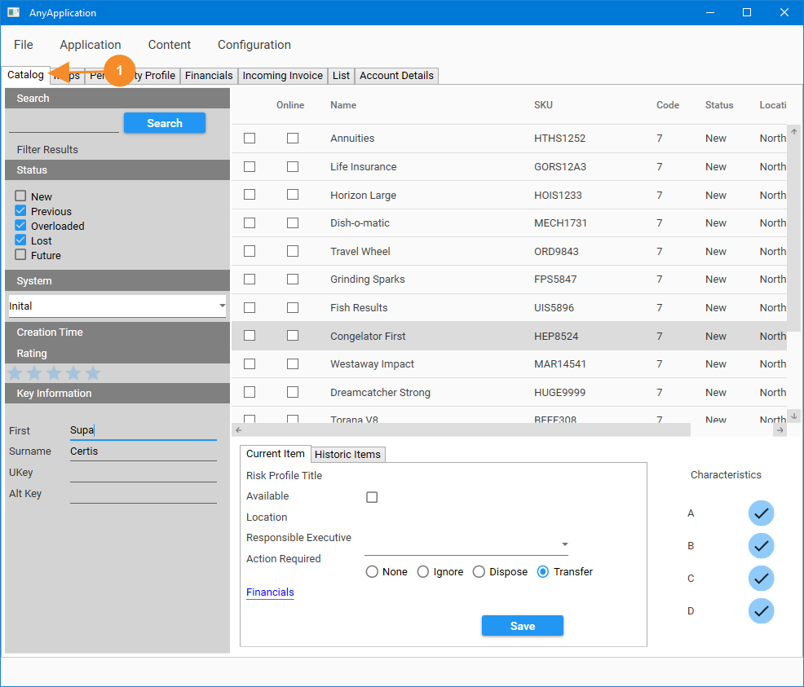
Catalog Options
Please navigate to the Catalog Tab in the Any Application.

Slide 3
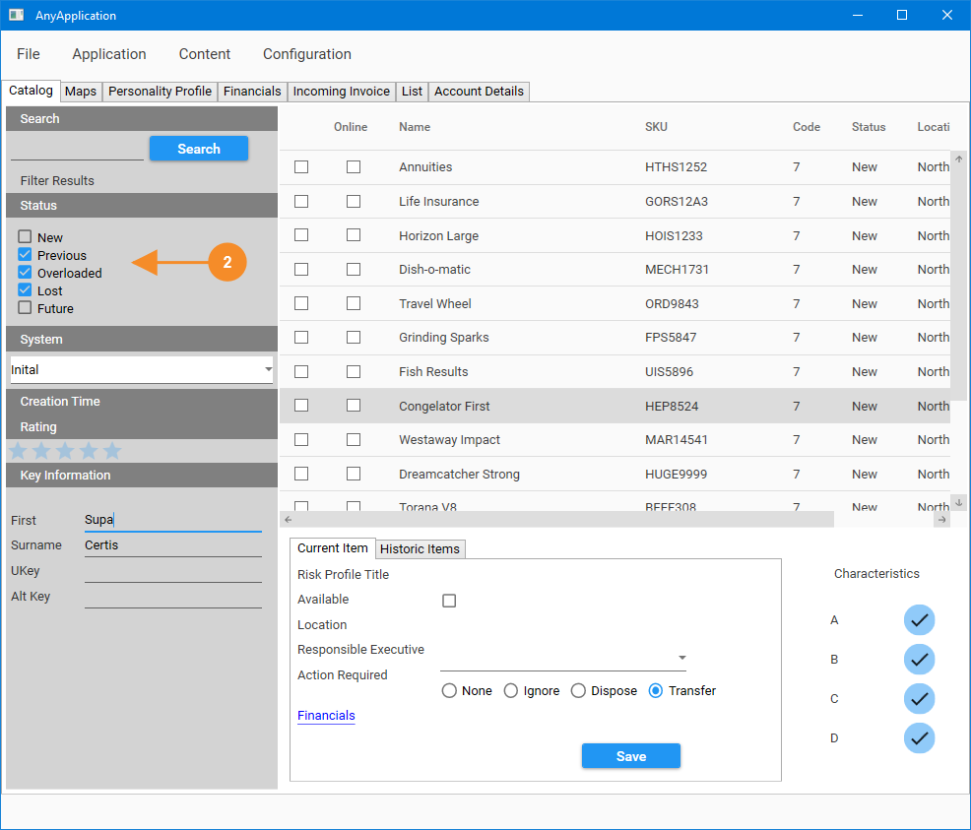
Catalog Options
In the Status section, select Previous, Overloaded and Lost. Deselect the other options.

Slide 4
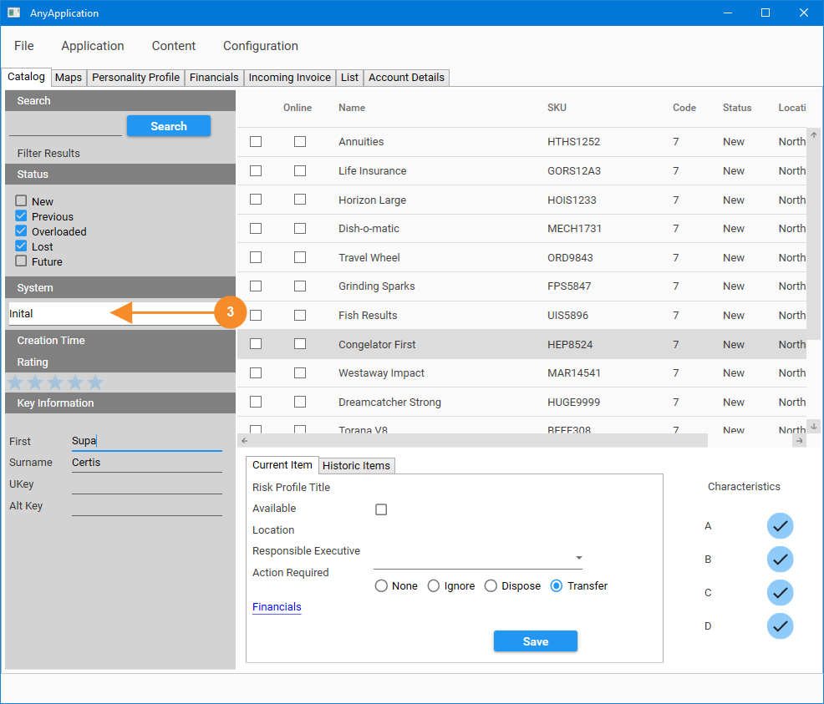
Catalog Options
Choose your system from the list.

Slide 5
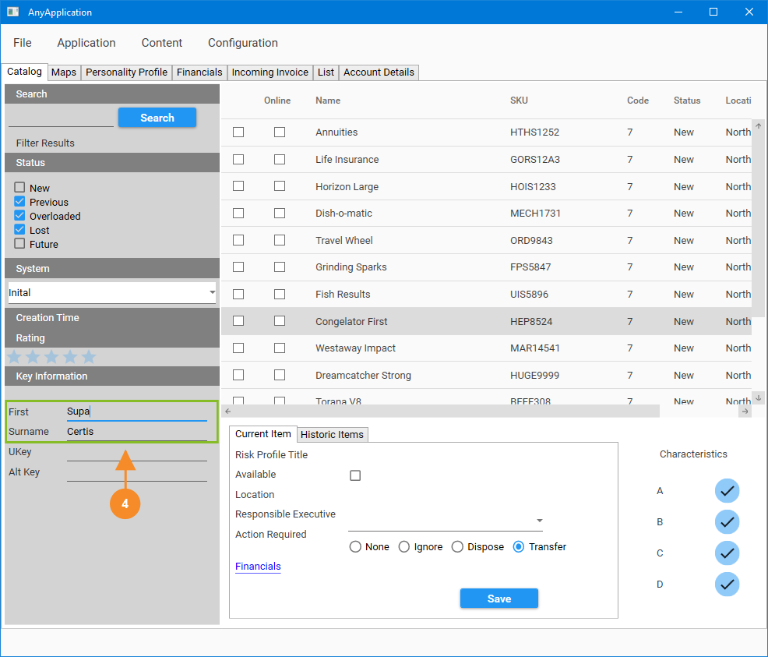
Catalog Options
Complete the name fields with the full legal name of the customer.

Slide 6
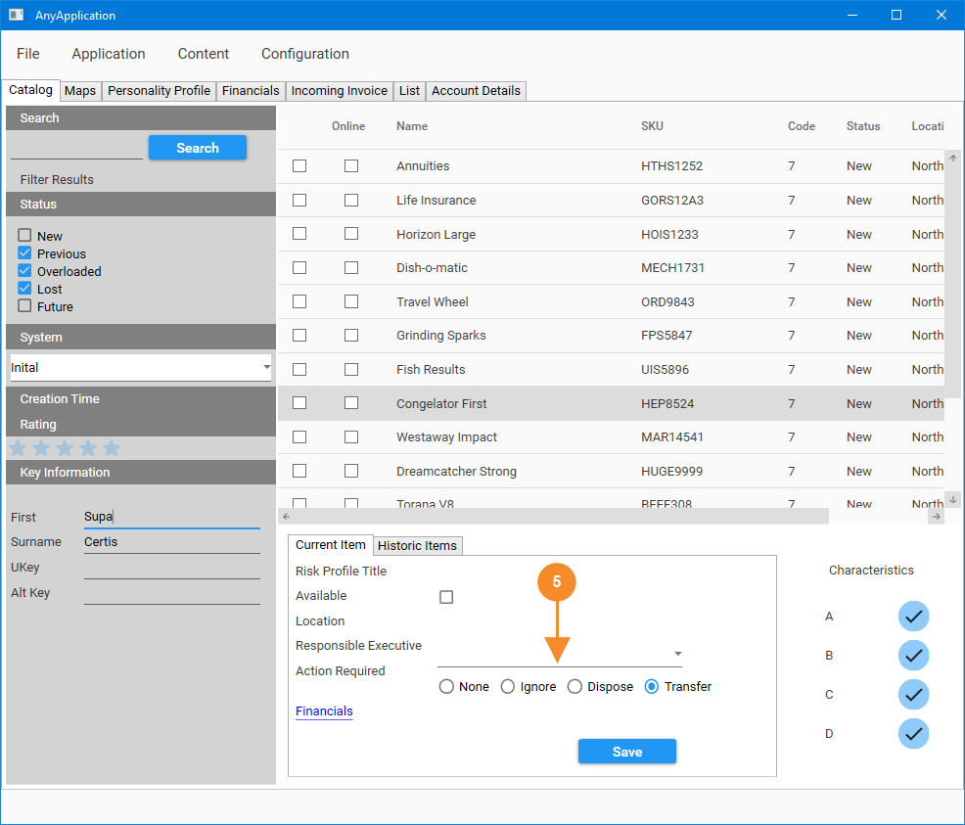
Catalog Options
You must select an Action before continuing.

Slide 7
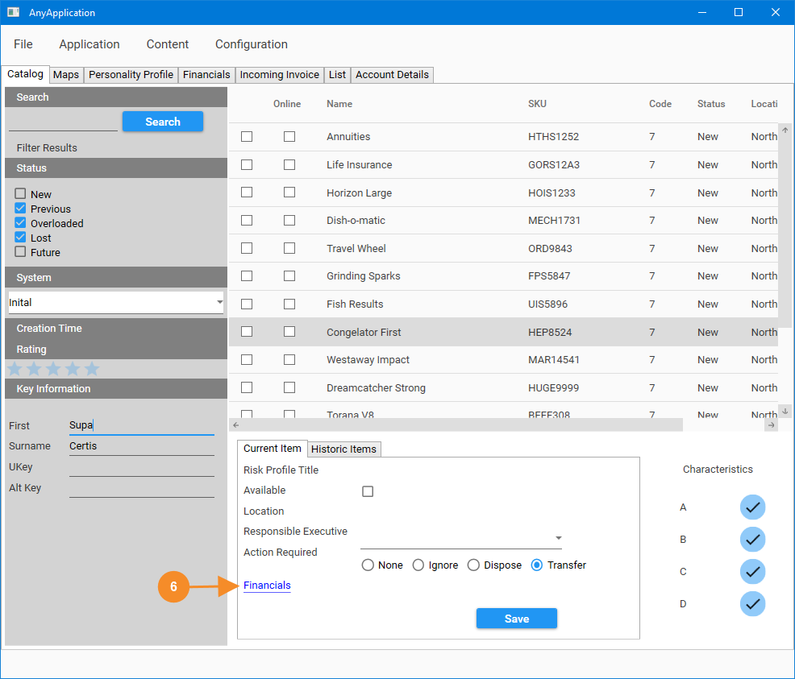
Catalog Options
Press Financials to move to the Financial Information Window.

Slide 8
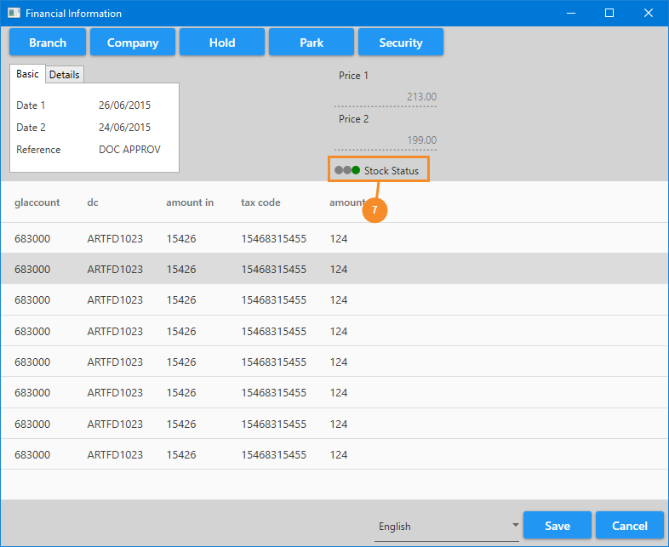
Financial Information
In the Financial Information Window, check that the stock status shows a green indicator as shown here. If not, please do not complete this activity.

Slide 9
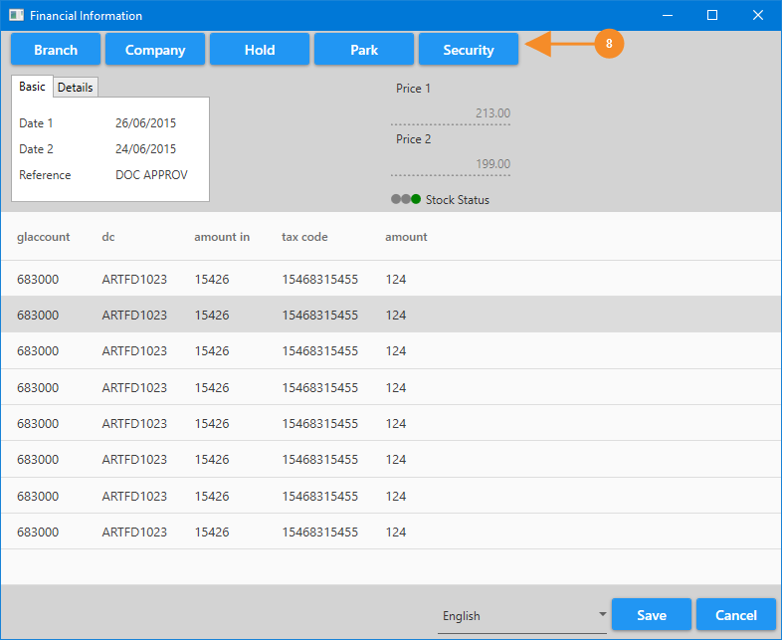
Financial Information
Press the Security Button to open the Security Settings Window.

Slide 10
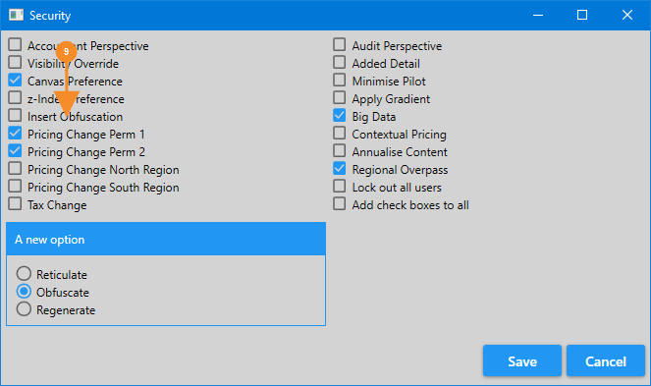
Security Settings
Here, you will select the relevant settings for Pricing. You should leave these options unchanged unless you have a specific need.

Slide 11
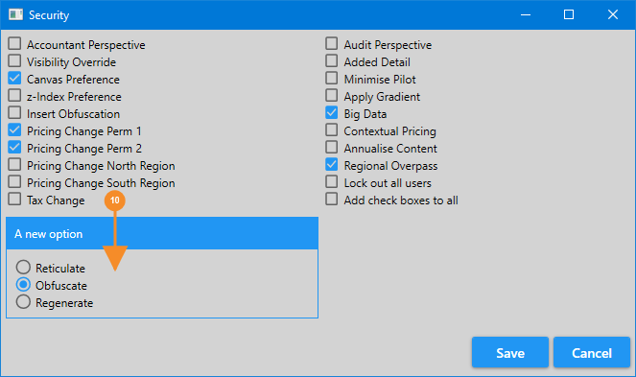
Security Settings
In the new option section please choose Obfuscate to hide secure information, choose Reticulate to organise the information, or Regenerate if there is a need for major corrective activity.

Slide 12
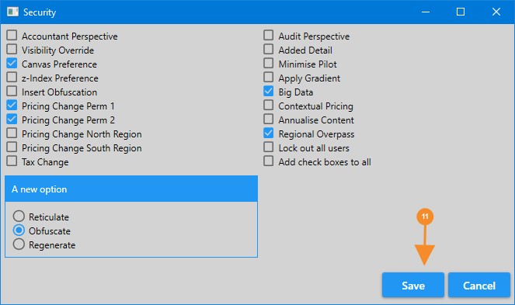
Security Settings
Press Save to Post the Transaction.

Slide 13
Summary
This is an example work created in Runthru Instruction.

